Slide 1
Acid-Base Equilibria:
Proton Transfer in Biological Systems
(Chapter OS 14, Gilbert 15)
Reminder to review the “Material that I expect you to know”

Slide 2
Outline
Acids and Bases: A Balancing Act
Acid Strength and Molecular Structure
Covering the Bases
pH and the Autoionization of Water
K_{a}, K_{b}, and the Ionization of Weak Acids and Bases
Calculating the pH of Acidic and Basic Solutions
Polyprotic Acids
Acidic and Basic Salts

Slide 3
Review: Naming Compounds & Writing Formulas
Binary acids
Contain hydrogen and a monoatomic anion (e.g., Cl⁻, S²⁻)
Most common binary acids are halogen-based
Example:
HBr
Step 1: Name the second element. This becomes the parent name of the overall compound.
Step 2: Replace the last syllable with –ic followed by a space and the word acid.
Step 3: Add the prefix hydro– to the parent name.
Br = bromine
bromic acid
hydrobromic acid
From Chapter 4

Slide 4
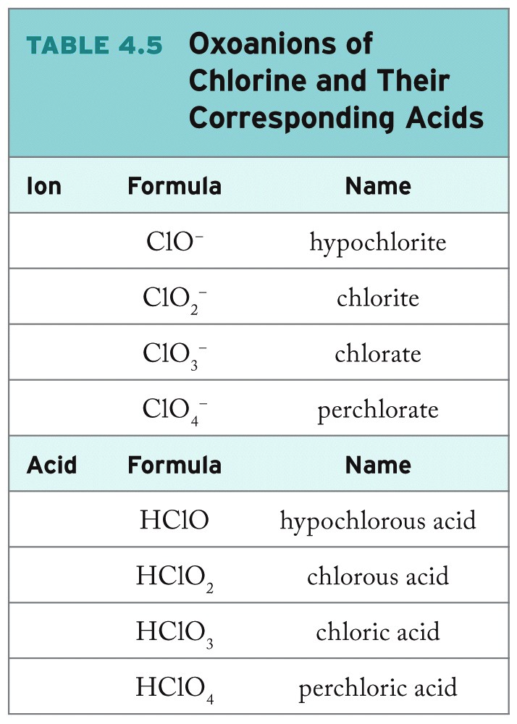
Review: Naming Oxoacids
If oxoanion name ends in:
-ate
-ite
Corresponding acid ends in:
-ic
-ous
From Chapter 4

Slide 5
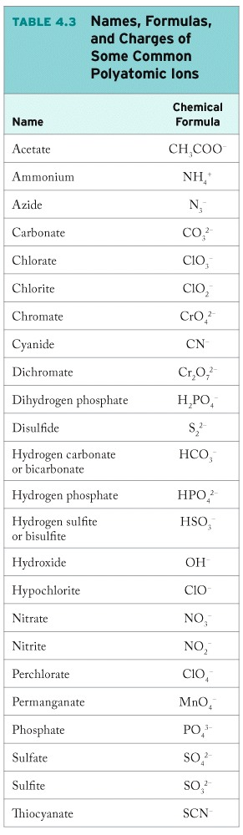
Naming Compounds & Writing Formulas
The presumption is that you know these polyatomic ions at this point!
(Chapter 4, p. 142)

Slide 6
Review: Acid-Base Reactions
Arrhenius Definitions:
Acids: Produce H₃O⁺ in solution
HCl(aq) + H₂O(ℓ) → H₃O⁺(aq) + Cl⁻(aq)
HA(aq) + H₂O(ℓ) ⇌ H₃O⁺(aq) + A⁻ (aq)
Bases: Produce OH⁻ in solution
NH₃(aq) + H₂O(ℓ) ⇌ NH₄⁺(aq) + OH⁻(aq)
B(aq) + H₂O(ℓ) ⇌ HB⁺(aq) + OH⁻ (aq)
H₃O⁺ simplified by leaving out water, often written as just H⁺
HA (aq) ⇌ H⁺(aq) + A⁻ (aq)
From Chapter 8

Slide 7
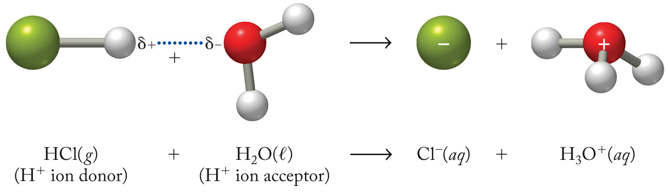
Brønsted-Lowry Model
Brønsted–Lowry acid: H⁺ ion donor
Brønsted–Lowry base: H⁺ ion acceptor

Slide 8
Conjugate Acid-Base Pairs
Conjugate acid–base pairs:
Differ from each other only by the presence or absence of a proton (H⁺)
HNO₂(aq) + H₂O(ℓ) ⇌ H₃O⁺(aq) + NO₂⁻(aq)
Acid donates H⁺ to form base
Base accepts H⁺ to form acid

Slide 9
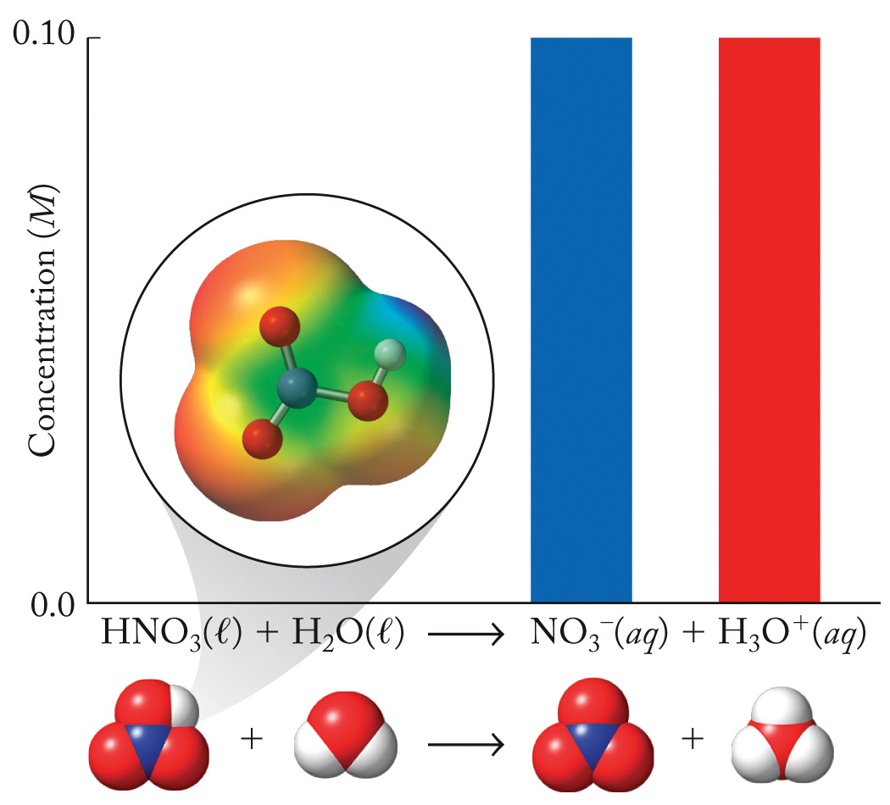
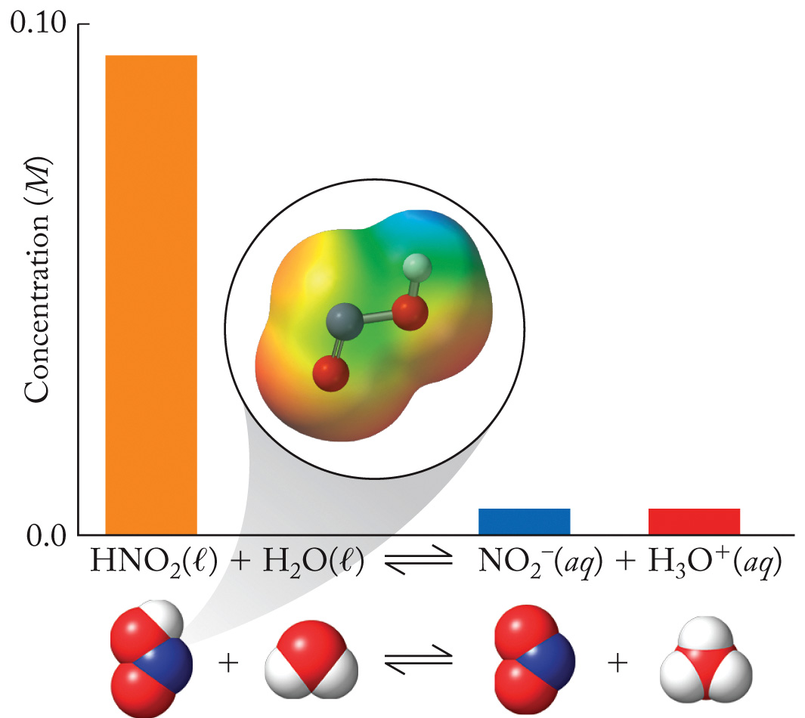
Strong and Weak Acids
Strong Acid: “Completely” ionized
K_{a} > 1
HNO₃(aq) + H₂O(ℓ) → NO₃⁻(aq) + H₃O⁺(aq)
(H⁺ donor)
(H⁺ acceptor)
K_{a} = 24
Weak Acid: Partially ionized
K_{a} < 1
HNO₂(aq) + H₂O(ℓ) ⇌ NO₂⁻(aq) + H₃O⁺(aq)
(H⁺ donor)
(H⁺ acceptor)
K_{a} = 7.2 × 10⁻⁴
Notes:
Strong acids have a Ka > 1

Slide 10
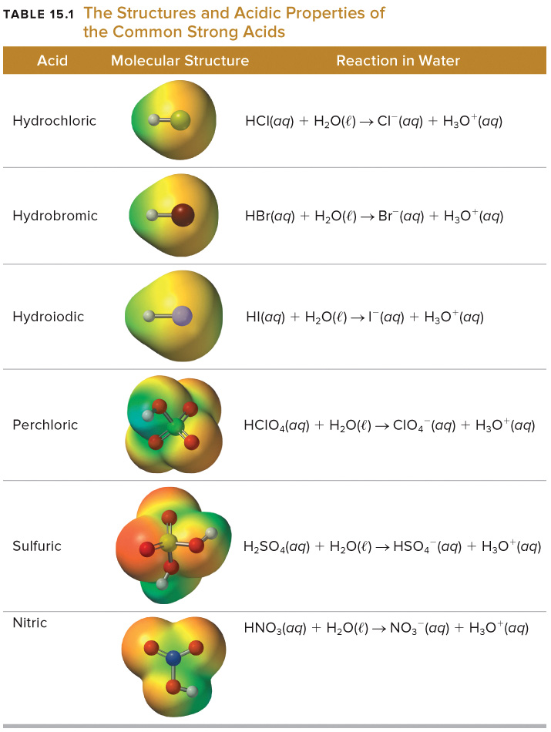
Strong Acids
NOT HF K_{a} = 6.8x10^{–4}

Slide 11
Strong Acids

Slide 12
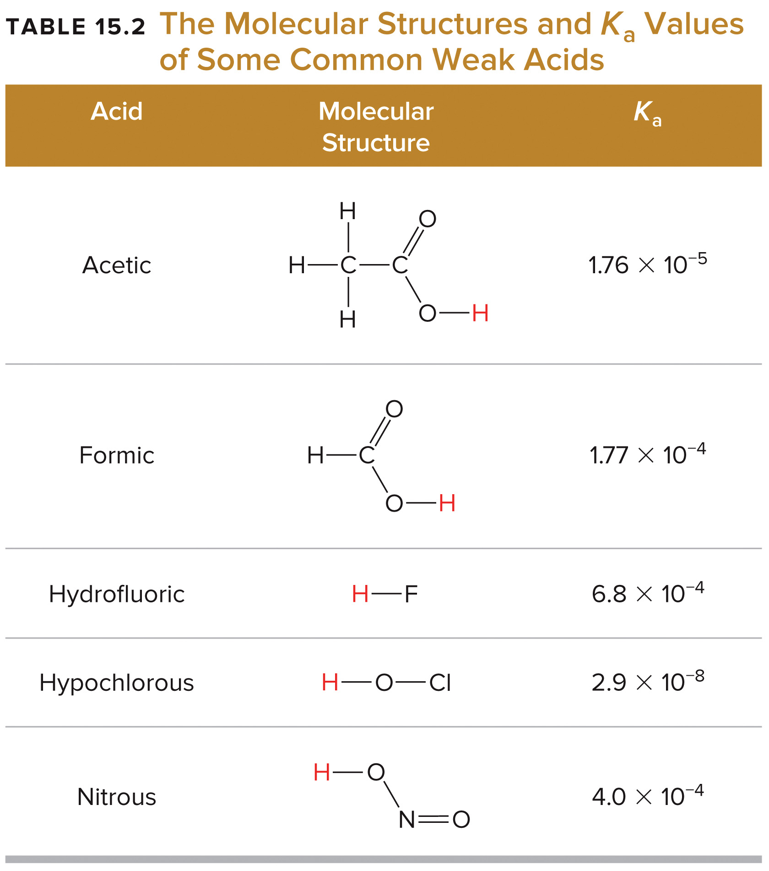
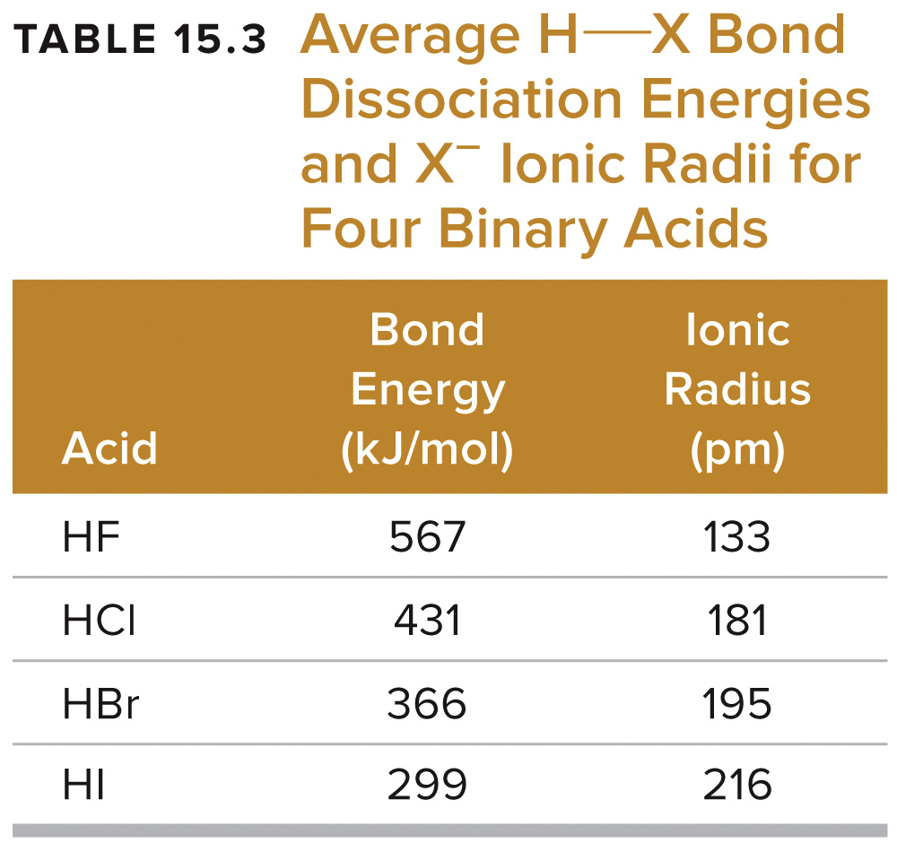
Weak Acids
Why is HF a weak acid when the other binary halides are strong acids?

Slide 13
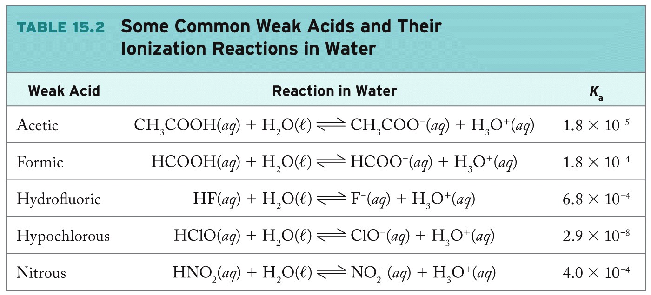
Weak Acids
Pay attention to HNO₂ (Nitrous) vs HNO₃ (Nitric (K_{a}=24)

Slide 14
Strong and Weak Bases
Strong Bases: Completely dissociate in solution
Example: oxides/hydroxides of Groups 1, 2
Weak Bases: Do not completely dissociate in solution
Example: some nitrogen-containing compounds
NH₃(aq) + H₂O(ℓ) ⇌ NH₄⁺(aq) + OH⁻(aq)
(base) (conjugate acid)

Slide 15
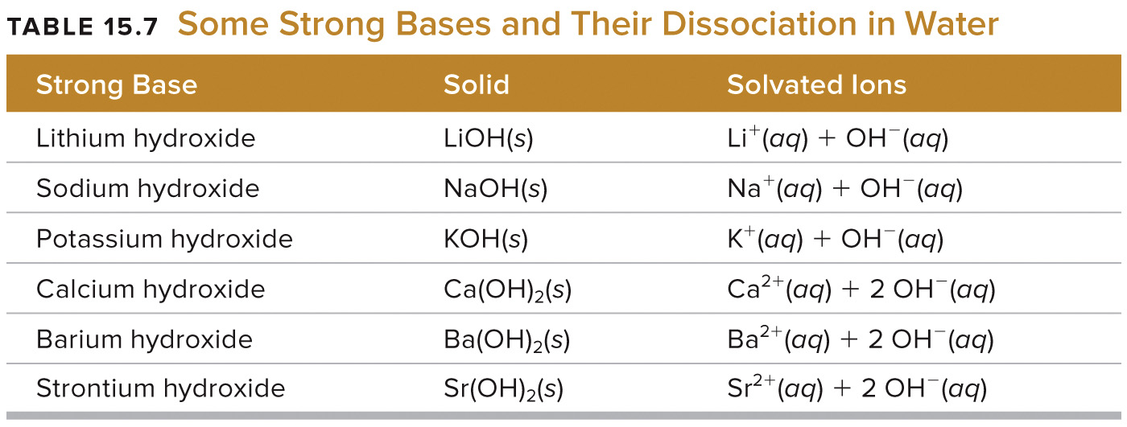
Strong Bases
Mg(OH)₂ insoluble, used as an antiacid.
Some sources call RbOH pKa -1.76 Ka =57.54 and CsOH pKa -1.4 Ka =25.12 strong bases.
Notes:
RbOH, CsOH also ? Get reliable source.

Slide 16
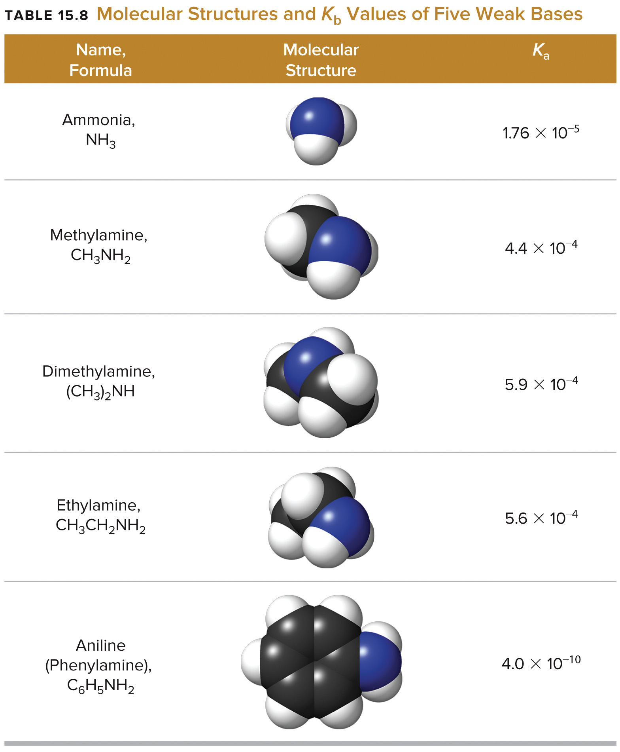
Weak Bases

Slide 17
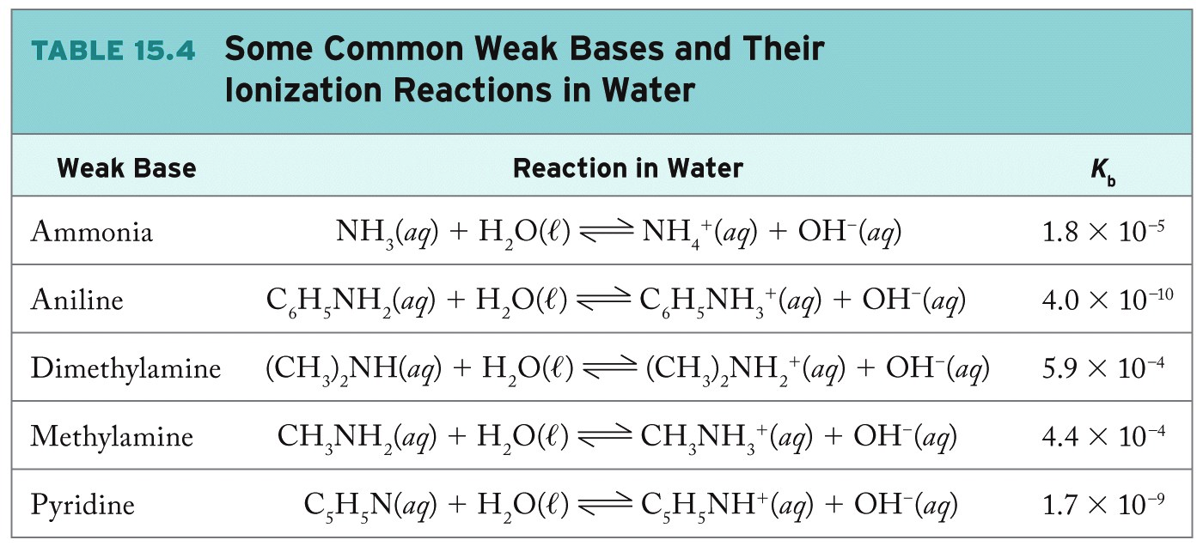
Weak Bases
Lewis Structure:
Lone electron pair is going to attract a proton.

Slide 18
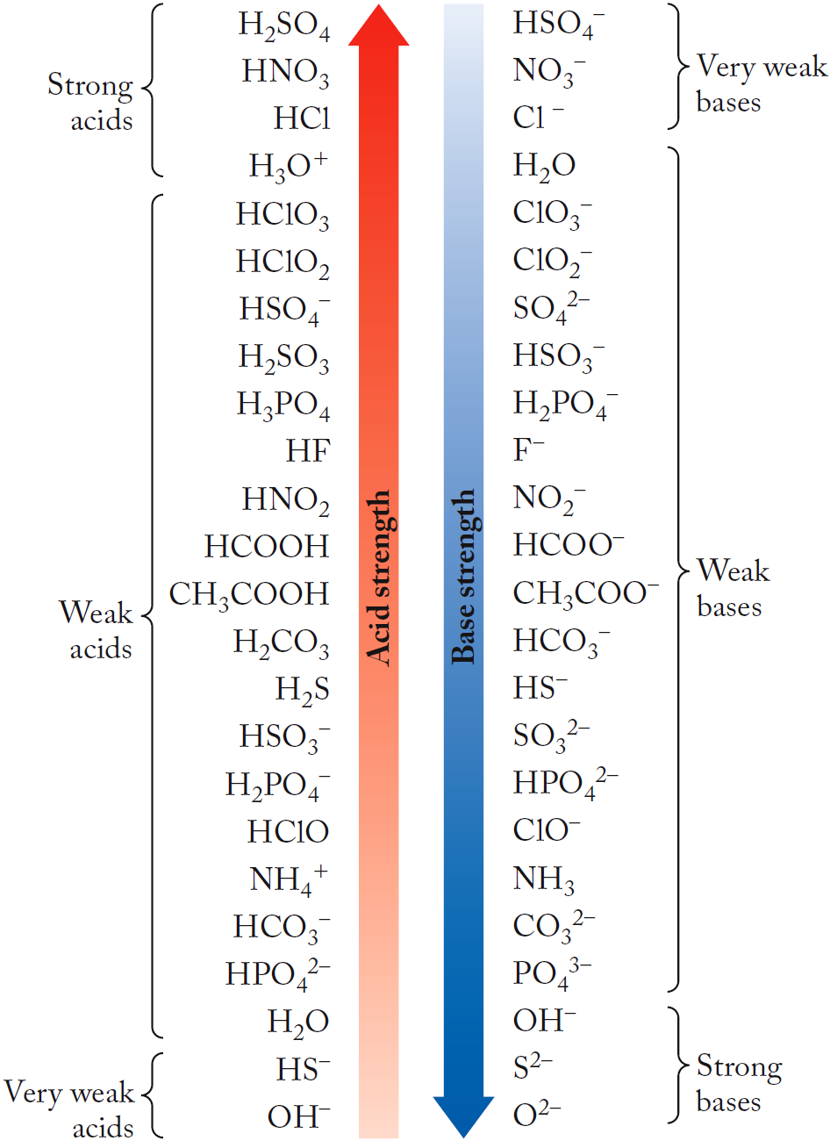
Relative Strengths of Acids/Bases
Conjugate base of a strong acid is very weak
Leveling Effect:
H₃O⁺ is the strongest H⁺ donor that can exist in water.
Strong acids all have the same strength in water; they are completely converted into H₃O⁺ ions.
Conjugate acid of a strong base is very weak
Notes:
Anything that passes H3O+ and OH- will functionally have the same strength
Strong acids have weak very weak conjugate bases and vice versa

Slide 19
Review so far:
Names and formulas of common acids and bases
Definitions
Conjugate pairs
Which are Strong Acids, Which are weak?
Factors affecting strength
Autoionization of Water
pH scale

Slide 20
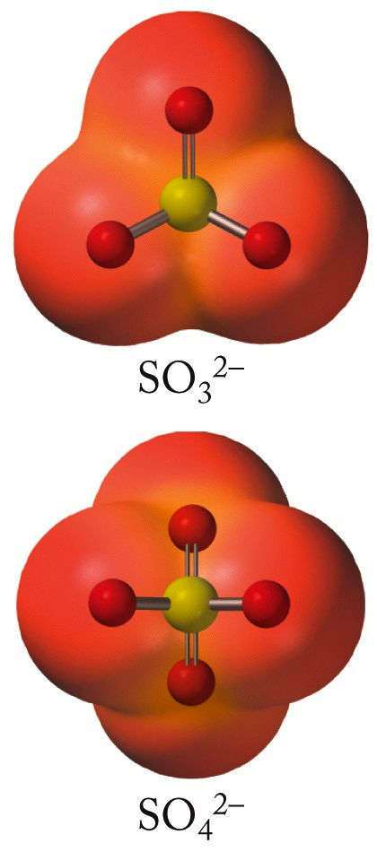
Factors Affecting Acid Strength
Charge delocalization:
Greater number of oxygen atoms in anion provides greater stability due to delocalization of the negative charge over more electronegative atoms
Consequence: H₂SO₄ is a much stronger acid than H₂SO_{3.}
Notes:
H2SO4 is stronger because SO4 2- has more ways to distribute the 2- charge than SO3 2-

Slide 21
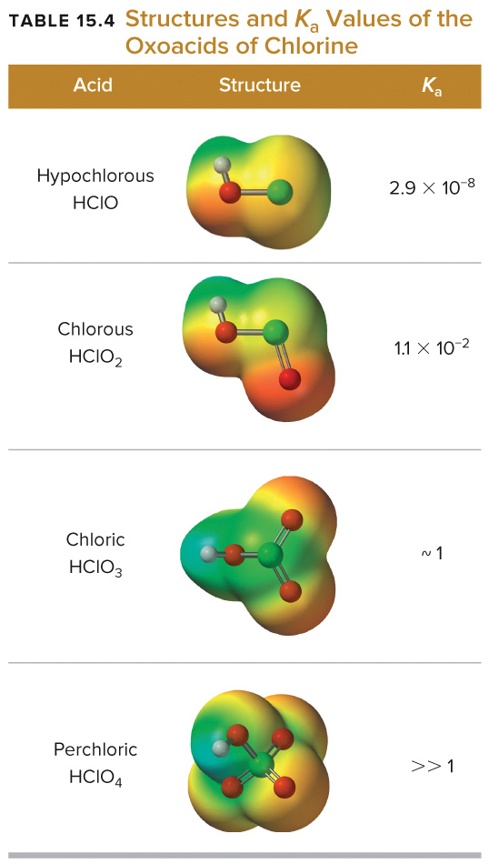
Factors Affecting Acid Strength
Oxidation Number:
The greater the number of oxygen atoms, the stronger the acid
Same sort of idea as charge delocalization.

Slide 22
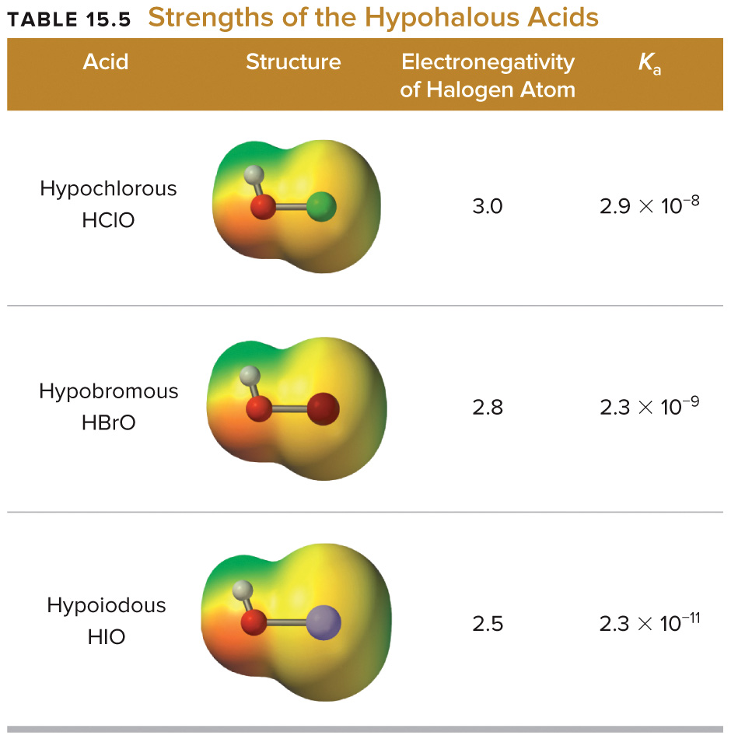
Electronegativity and Acid Strength
Electronegativity / Acid Strength
Pulling electron-density away from the central oxygen, thus making it easier to remove the hydrogen.
Notes:
More electronegative atoms can pull electrons further away from oxygen making it more positive that makes it easier to push H+ ions away

Slide 23
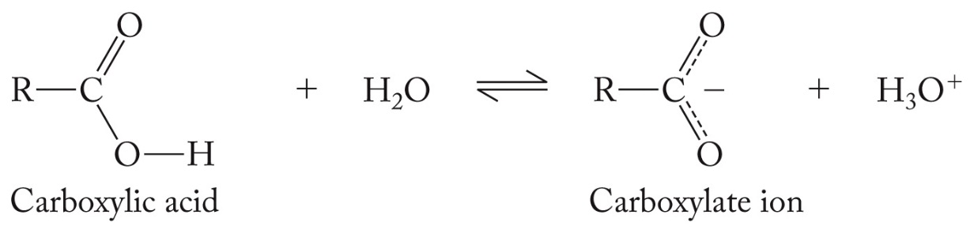
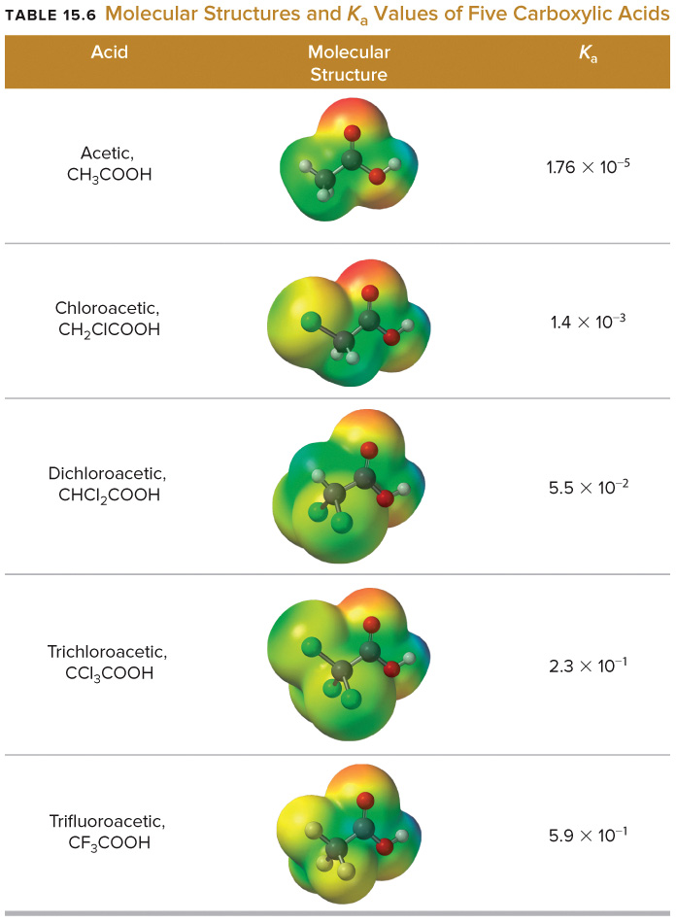
Carboxylic Acids
Charge is delocalized in anion due to resonance.
Electronegative elements on R increase acid strength, pulls electron density away from O—H bond

Slide 24
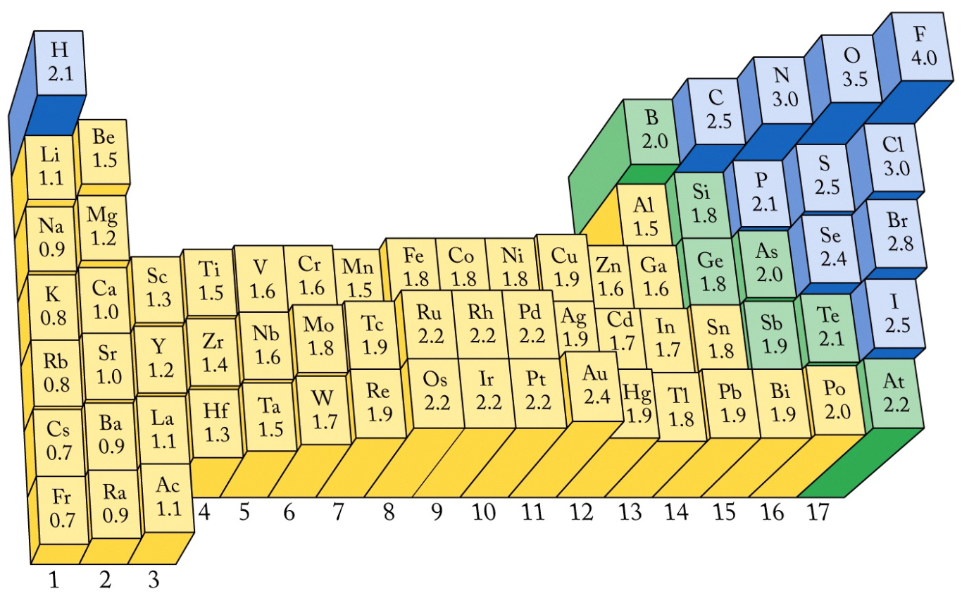
Review: Electronegativity
Electronegativity (EN):
Relative ability of an atom to attract electrons in a bond to itself.
Increases
Pauling Electronegativity
Scale
Increases
From Chapter 4

Slide 25
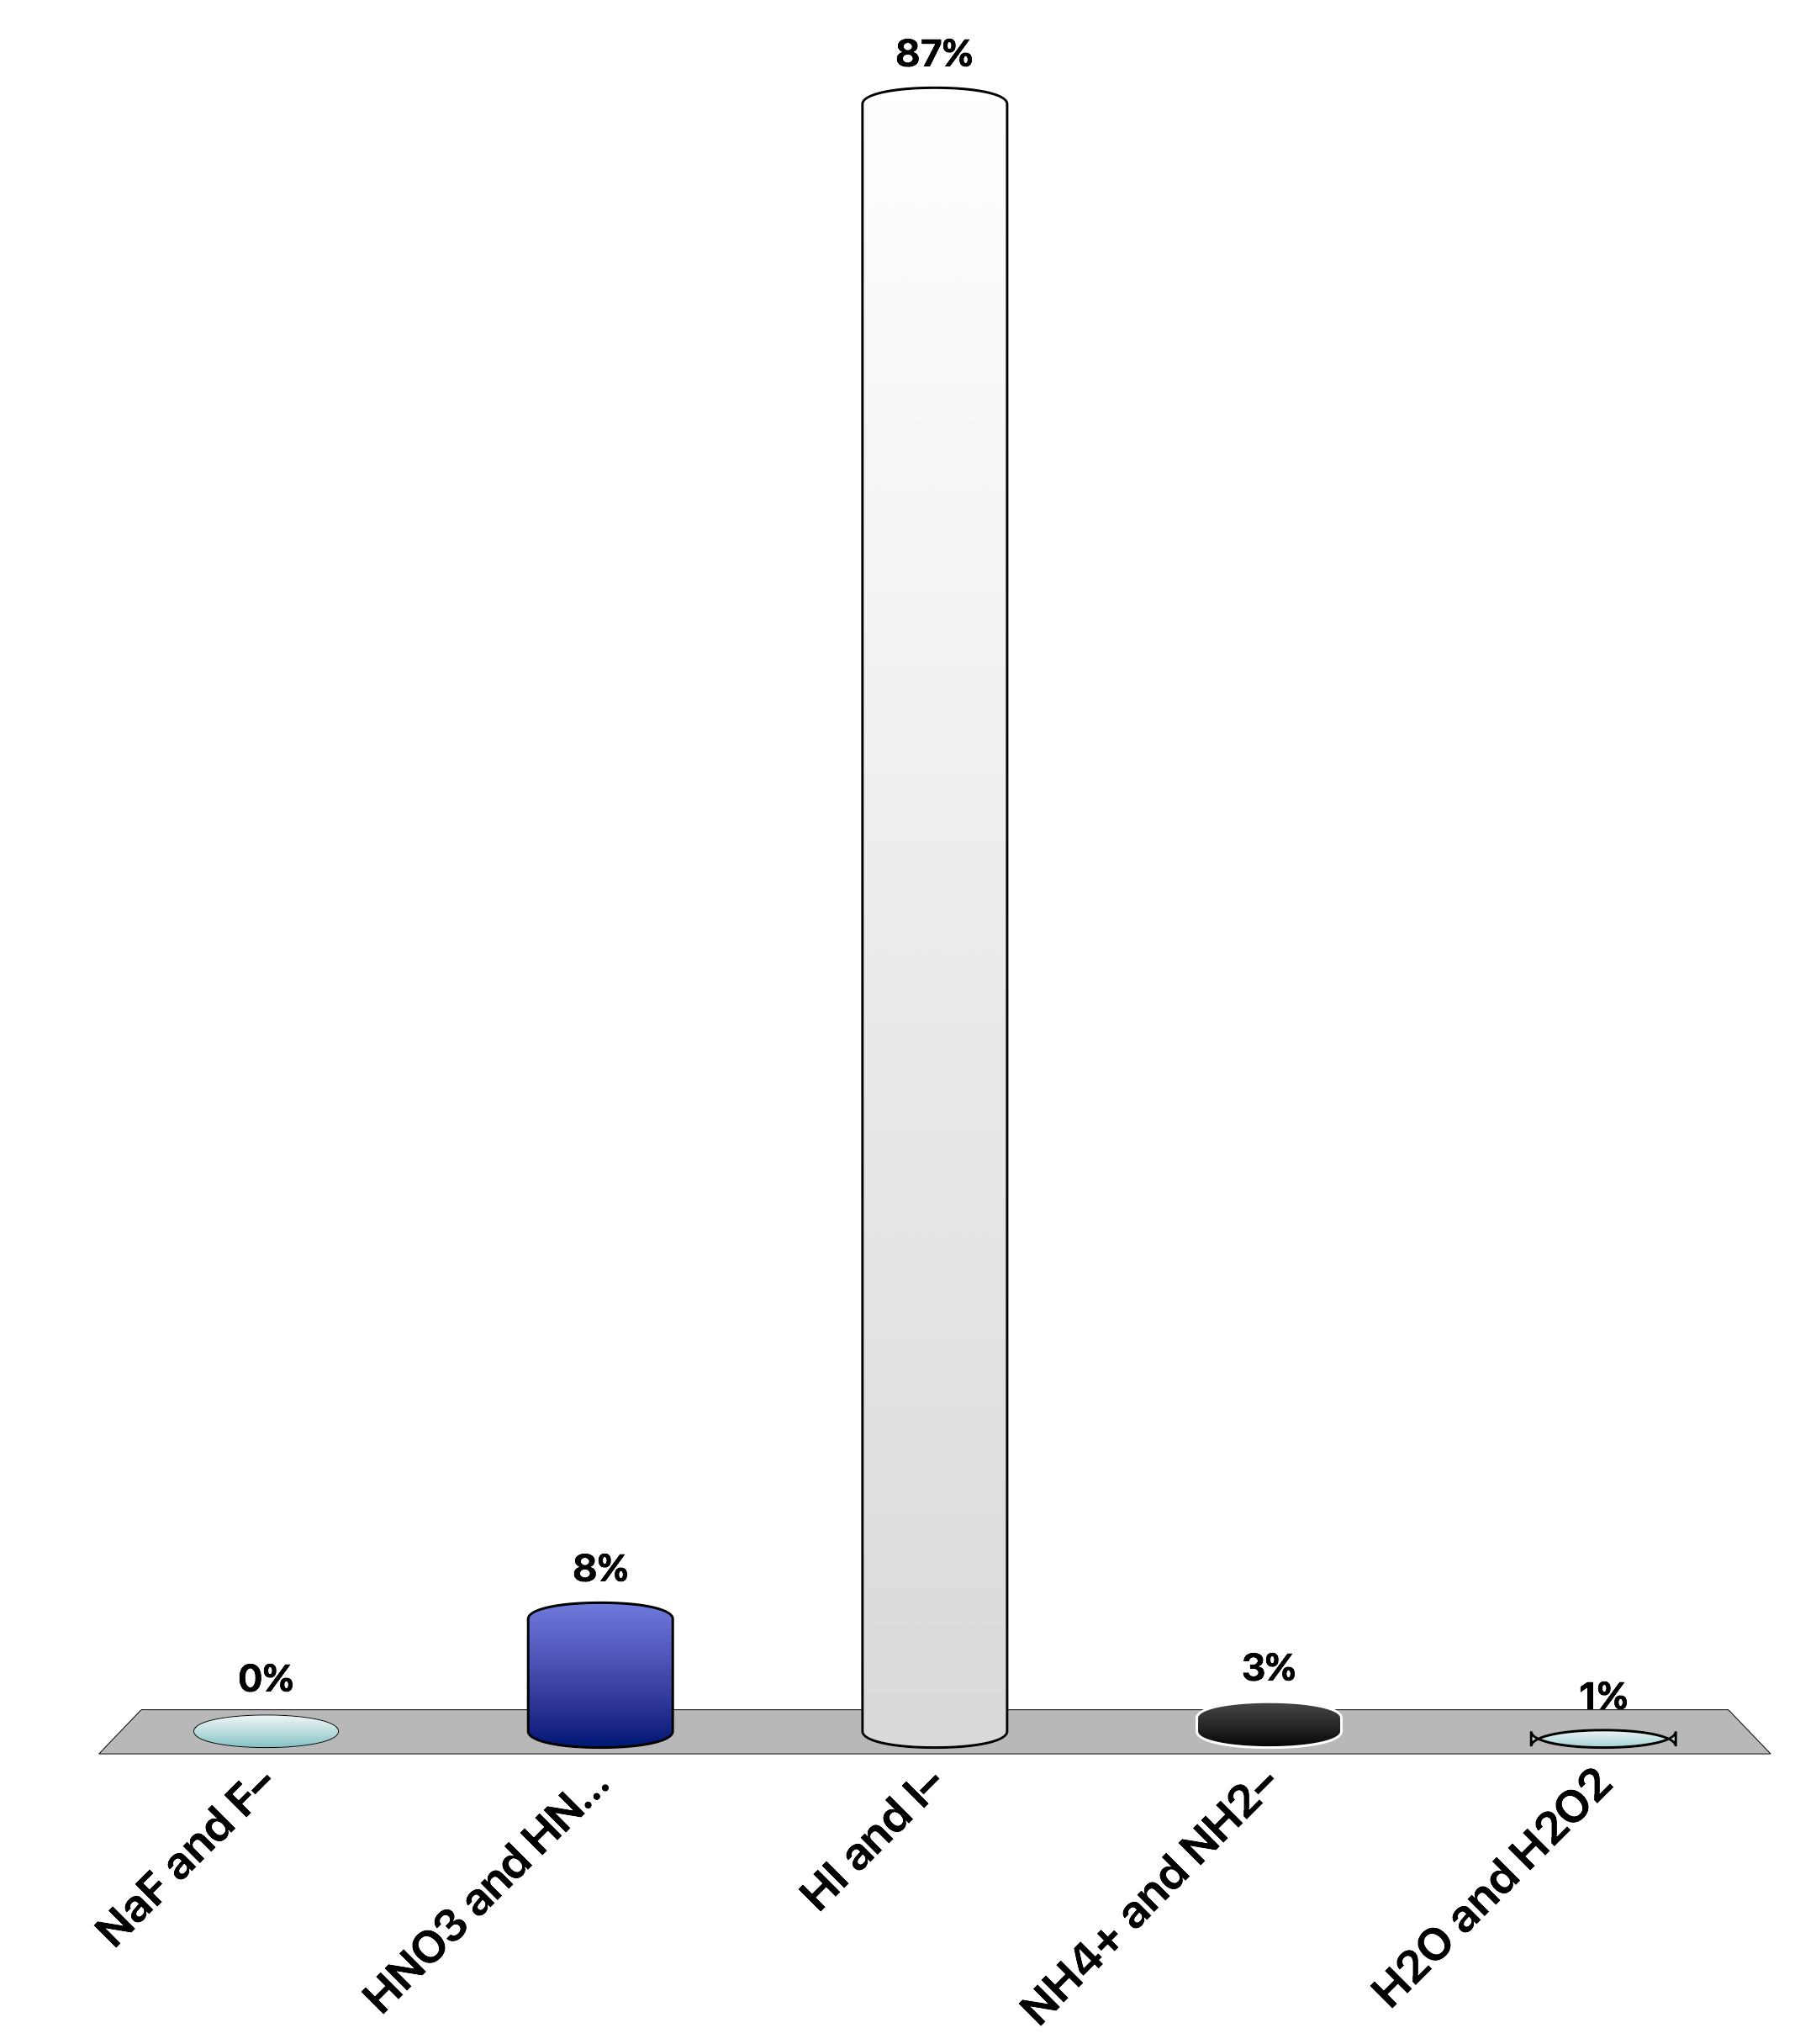
Which one of the following is a conjugate acid–base pair?
Practice: Conjugate Acids-Bases
NaF and F–
HNO₃ and HNO₂
HI and I–
NH₄⁺ and NH₂–
H₂O and H₂O₂

Slide 26
Review: Is Water an Acid or Base?
Water as Base:
Water as Acid:
Amphiprotic: Acts as acid or base
HCl (aq) + H₂O(ℓ) → H₃O⁺ (aq) + Cl⁻(aq)
Proton donor (acid)
Proton acceptor (base)
NH₃ (aq) + H₂O (ℓ) ⇌ NH₄⁺ (aq) + OH⁻(aq)
Proton acceptor (base)
Proton donor (acid)
From Chapter 8

Slide 27
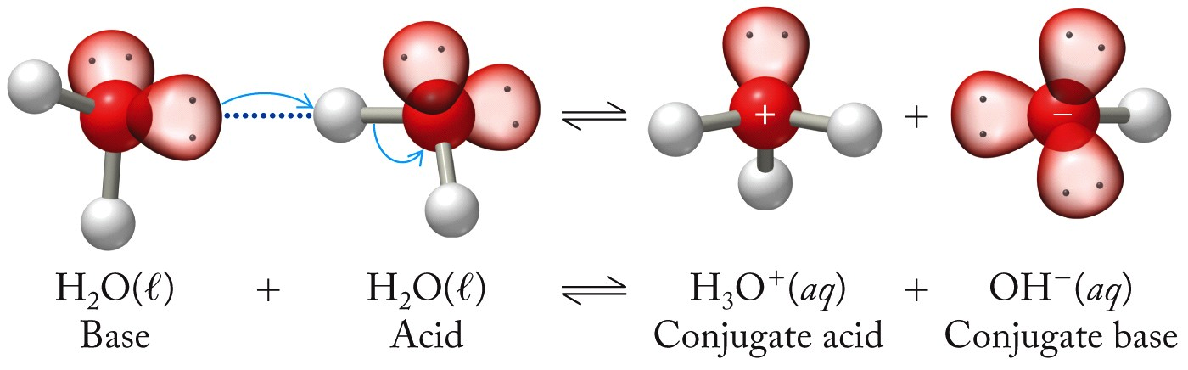
Autoionization of Water
ion-product constant for water
In absence of other acids or bases at 298 K: [H₃O⁺] = [OH⁻] = 1×10⁻⁷ M

Slide 28
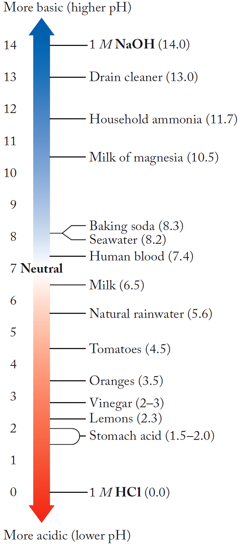
The pH Scale
To avoid writing exponential quantities all the time, take the –log of both sides:
Similarly, given the equilibrium constant for water:
If the –log of both sides is taken:

Slide 29
Example: pH and pOH
What are the [H⁺] and [OH⁻] in household ammonia, an aqueous solution that has a pH of 11.70?
Relationship between pH, pOH and concentrations:
Relationship between pH and pOH:

Slide 30
Acid Dissociation Equilibrium
Weak Acids: equilibrium between acid (on left) and ions (on right)
HA(aq) + H₂O(ℓ) ⇌ A⁻(aq) + H₃O⁺(aq)
Strong Acids: K_{a} >>1
Weak Acids: K_{a} < 1
HNO₂(aq) + H₂O(ℓ) ⇌ H₃O⁺(aq) + NO₂⁻(aq)
Using K_{a} expression:
If pH is known, can calculate K_{a}
If K_{a} is known, solve equilibrium problem to calculate [H⁺] and pH

Slide 31
Practice: Calculation of pH
Calculate and compare [H⁺] and pH for a 0.100 M solution of HClO₄ and a 0.100 M solution of HClO (K_{a} = 2.9×10⁻⁸).
Perchloric acid is a strong acid, assume that essentially dissociates completely:
HClO₄(aq) + H₂O(ℓ) → ClO₄⁻(aq) + H₃O⁺(aq)
[HClO₄] = [H₃O⁺] = 0.100 M
so,
Hypochlorous acid is a weak acid, dissociates partially:
HClO(aq) + H₂O(ℓ) ⇌ ClO⁻(aq) + H₃O⁺(aq)
To avoid use of quadratic formula, simplify expression:
Can make a table, as we need equilibrium concentrations!
Recognize: x << 0.1
Notes:
Because HCLO has a very small Ka, x will be much smaller than 0.1 and round the denominator to 0.1

Slide 32
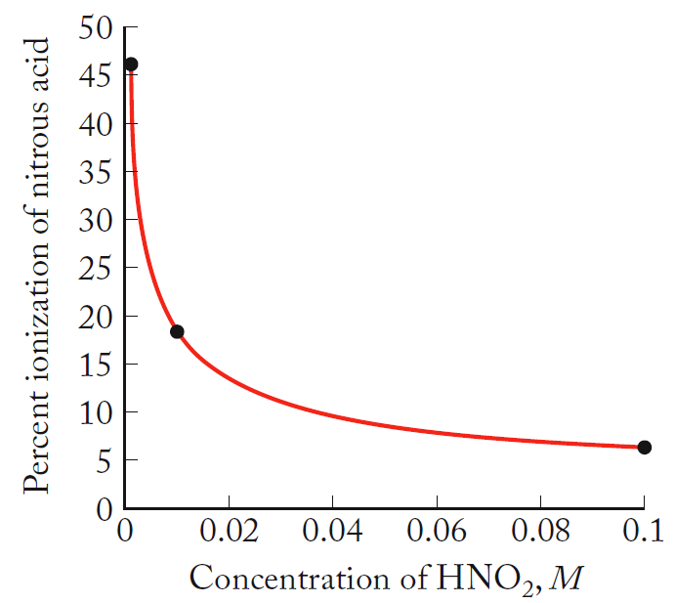
Weak Acids: Percent Ionization
Degree of Ionization:
Percent Ionization: Degree of ionization expressed as a percentage
% ionization decreases as [HA]₀ increases

Slide 33
Practice: Weak Acid Calculations
15.52. Rancid Butter The odor of spoiled butter is due in part to butanoic acid, which results from the chemical breakdown of butter fat. A 0.100 M solution of butanoic acid is 1.23% ionized. Calculate the value of K_{a} for butanoic acid.
butanoic acid(aq) + H₂O(ℓ) ⇌ (butanoate)⁻(aq) + H₃O⁺(aq)
 | butanoic acid | butanoate | H₃O⁺
Initial (M)
Change (M)
Equilibrium (M)
0.100
0
0
-x
+x
+x
0.100 -x
+x
+x

Slide 34
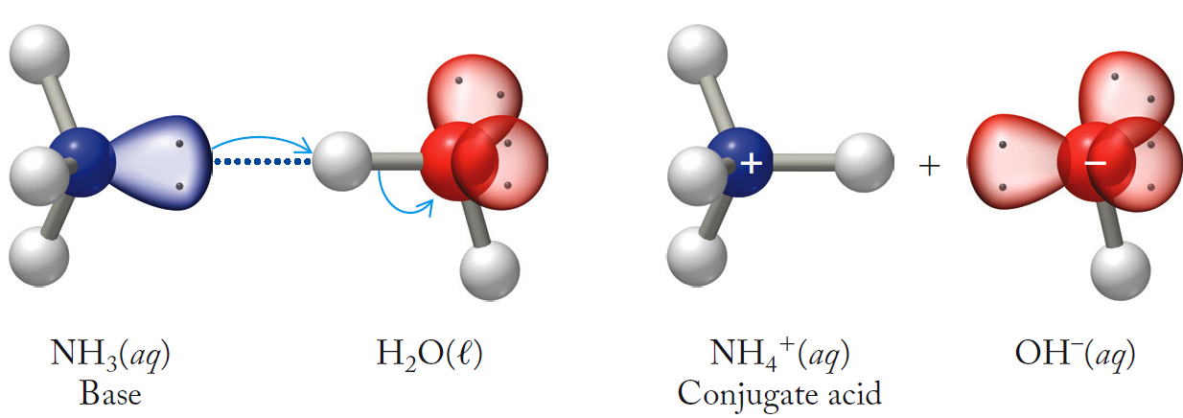
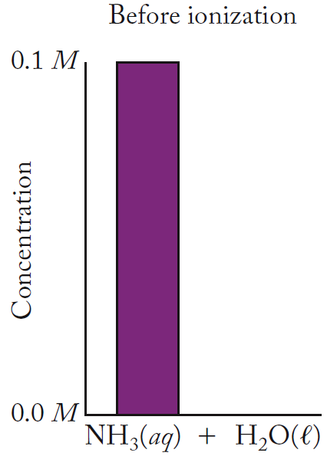
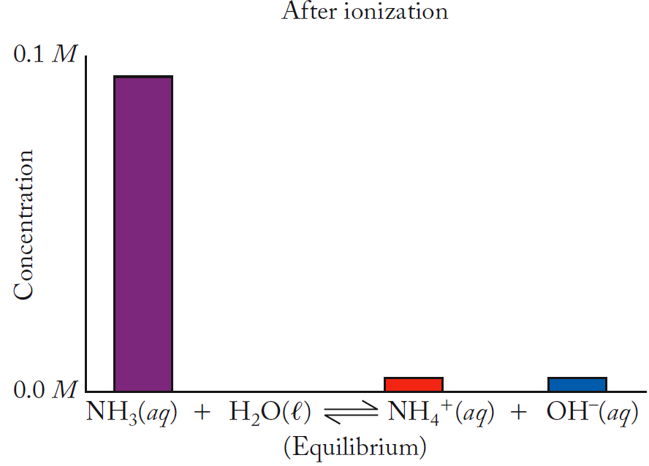
Weak Bases
NH₃ (aq) + H₂O (ℓ) ⇌ NH₄⁺ (aq) + OH⁻(aq)
Molecular picture
Lone pair of electrons attracts the H⁺ from water
ammonium ion is formed and a new lone pair on the oxygen
Notice: for a weak base the equilibrium lies heavily on reactants, little consumption

Slide 35
Base Dissociation Equilibrium (K_{b})
Weak Bases: equilibrium between base (on left) and ions (on right)
B(aq) + H₂O(ℓ) ⇌ HB⁺(aq) + OH⁻(aq)
NH₃(aq) + H₂O(ℓ) ⇌ NH₄⁺(aq) + OH⁻(aq)
If tasked with calculating pH: Obtain [OH⁻] at equilibrium, then use K_{w} relationship to relate [OH⁻] to [H⁺]:

Slide 36
Practice: Weak Base Calculations
15.62 Pyridine (C₅H₅N) is a particularly foul-smelling substance used in manufacturing pesticides and plastic resins. Calculate the pH of 0.125 M solution of pyridine.
⁺
C₅H₅N(aq) + H₂O(ℓ) ⇌ C₅H₅N-H (aq) + OH⁻(aq)
Solve for x:
 | C₅H₅N | C₅H₅N-H | OH⁻
Initial (M)
Change (M)
Equilibrium (M)
0.125
0
0
-x
+x
+x
Calculate pOH:
0.125 -x
+x
+x
To avoid use of quadratic equation, simplify expression:
Determine pH:
Recognize: x << 0.125

Slide 37
Relationship Between K_{a} and K_{b}
Generalized reaction for an acid:
HA(aq) + H₂O ⇌ H₃O⁺(aq) + A⁻(aq)
A⁻(aq) + H₂O ⇌ OH⁻(aq) + HA(aq)
H₂O(ℓ) + H₂O(ℓ) ⇌ H₃O⁺(aq) + OH⁻(aq)
K_{a}
Generalized reaction for its conjugate base:
+
K_{b}
K_{w}
K_{w} = K_{a}×K_{b}
Notes:
Note: Animation – add arrows to show how species cancel

Slide 38
Polyprotic Acids
Polyprotic Acid: more than one ionizable H atom/molecule
Example: Acid precipitation
SO₃(g) + H₂O(ℓ) → H₂SO₄(aq)
H₂SO₄(aq) → H⁺(aq) + HSO₄⁻(aq) K_{a1} = large!
HSO₄⁻(aq) ⇌ H⁺(aq) + SO₄²⁻(aq) K_{a2} = 1.2×10⁻²

Slide 39
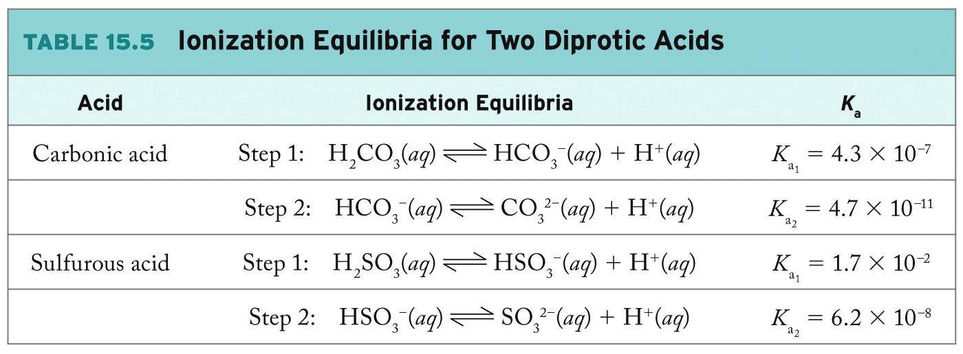
Diprotic Acids
K_{a1} > K_{a2} (more difficult to remove H⁺ ion from negatively charged anion)
Typically only first H⁺ affects pH (K_{a1})

Slide 40
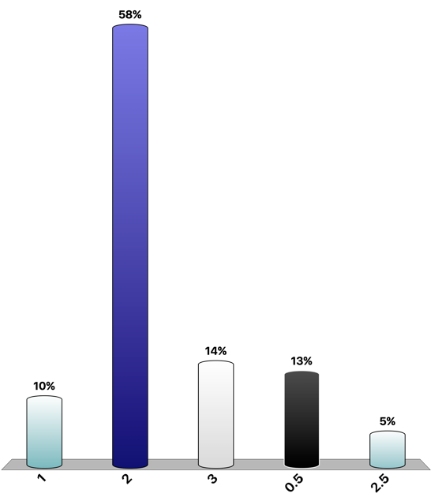
You have a solution of the weak acid HA and add some HCl to it. What are the major species in solution? What do you need to know to calculate the pH of solution, and how would you use this information? How does the pH of the solution of just the HA compare with that of the final mixture? Explain.
Discussion: Aqueous Equilibria

Slide 41
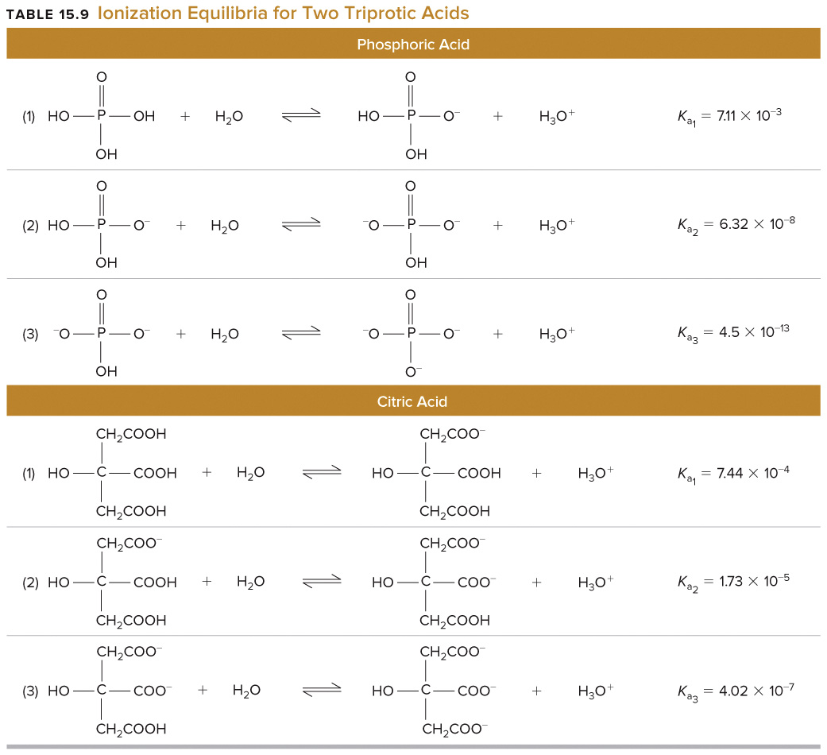
Triprotic Acids: Phosphoric Acid

Slide 42
Triprotic Acids: Citric Acid

Slide 43
Practice: pH of Diprotic Acids
Calculate the pH of 0.100 M carbonic acid solution (K_{a1} = 4.3 × 10⁻⁷ and K_{a2} = 4.7 × 10⁻¹¹).
H₂CO₃(aq) ⇌ H⁺(aq) + HCO₃⁻(aq)
⇌ H⁺(aq) + CO₃⁻(aq)
K_{a1}
K_{a2}
notice the second equilibrium is essentially a non-factor for pH
Assumption: x << 0.100
Notes:
Generally the first dissociation is the only one that matters because the second one will have a much smaller impact that it won’t show up

Slide 44
Chapter Outline
15.1 Acids and Bases: A Balancing Act
15.2 Acid Strength and Molecular Structure
15.3 Covering the Bases
15.4 pH and the Autoionization of Water
15.5 K_{a}, K_{b}, and the Ionization of Weak Acids and Bases
15.6 Calculating the pH of Acidic and Basic Solutions
15.7 Polyprotic Acids
15.8 Acidic and Basic Salts

Slide 45
Acid-Base Properties of Salts
Weak Acid:
HF(aq) + H₂O(l) ⇌ F⁻(aq) + H₃O⁺(aq)
(acid) (conj. base)
Salt:
NaF(s) → Na⁺(aq) + F⁻(aq)
F⁻(aq) + H₂O(l) ⇌ HF(aq) + OH⁻(aq)
(base) (conj. acid)
Salt: product of a neutralization reaction made up of the cation of the base and the anion of the acid. (pg 333)
Or
”Salt is another name for an ionic compound” (Zumdahl & Zumdahl pg 559)

Slide 46
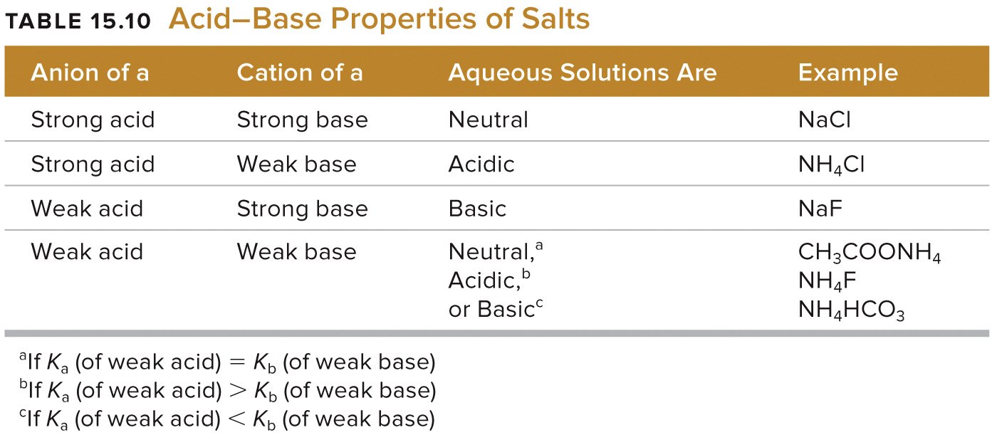
Acid-Base Properties of Salts
This is where it becomes important to recognize conjugate acid-base pairs, strengths of acids/bases
“What’s in the flask?”
Notes:
If conjugate base to a strong acid, then the solution will be acidic
If conjugate base to a strong base, the then solution will be basic.

Slide 47
pH of Salt Solutions
Write balanced equilibrium equation for basic anion or acidic cation.
CO₃²⁻(aq) + H₂O(l) ⇌ HCO₃⁻(aq) + OH⁻(aq)
Determine K for equilibrium (in this case, K_{b1}).
Solve equilibrium problem for [H⁺], [OH⁻].
These steps are actually really the key steps to any acid-base problem!

Slide 48
Practice: pH of a Basic Salt
Calculate the pH of 0.575 M sodium acetate.
NaCH₃COO(s) → Na⁺(aq) + CH₃COO⁻(aq)
CH₃COO⁻(aq) + H₂O(ℓ) ⇌ CH₃COOH(aq) + OH⁻(aq)
K_{b} is small, assume: x << 0.575 M
K_{b} is not listed in book, can use relationship: K_{w} = K_{a}×K_{b}
Can relate pOH to pH:
Substitute for equilibrium quantities:

